Slide 1
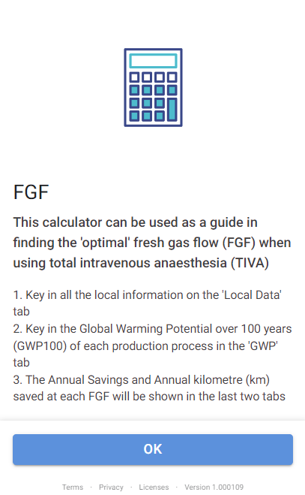
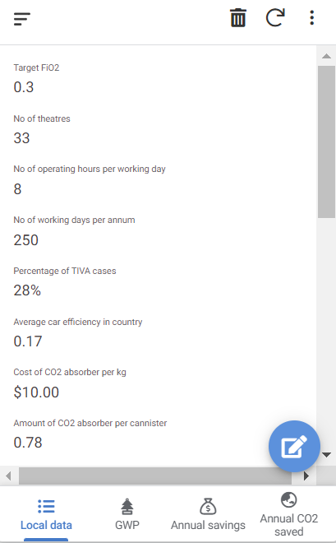
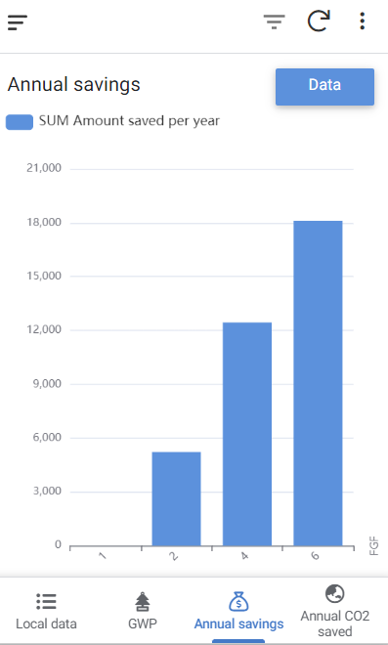
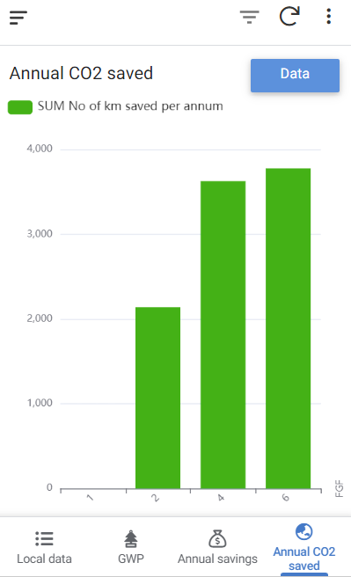
A Calculator: What is the optimal fresh gas flow (FGF) in Total Intravenous Anaesthesia (TIVA)?
Christine S. W. Wong, Pamela L. M. Ting, King Sin Ang, Suresh Parajonthy, Pei Kee Poh Department of Anaesthesia, National University Hospital, Singapore.
Introduction
Increasing FGF to a circle anaesthesia breathing system has been shown to significantly reduce carbon dioxide (CO₂) absorbent consumption. This could bring about a positive economic impact when utilising TIVA, though the environmental benefits have been challenged due to differences in geographical grid emission factors¹ and waste disposal methods². We designed a calculator to allow institutions to compute their costs and the associated environmental impact at different fractions of inspired oxygen (FiO₂) and FGF across different countries.
Methods
A calculator was made using Google Sheets (Google LLC, USA) and translated into an app on AppSheet (Google LLC, USA) to allow a more user-friendly experience.
By setting the target FiO₂ at 30%, 40%, 50% and 60%, the flow of oxygen and medical air is calculated for FGF of 1, 2, 4, and 6 L/min, respectively. The local costs of medical gases at each FGF are added to the cost of purchasing and disposal of CO₂ absorbent and divided by the median time to exhaustion of CO₂ absorbent at different FGF (median time results obtained from Zhong G et al²). This allows us to obtain the total cost per hour. The cost saved each year when increasing FGF from 1 L/min to 2, 4, and 6 L/min, respectively, is then calculated by considering the number of theatres and operating hours per year.
The environmental impact of each gas production and that of soda lime production and disposal, quantified as 100-year global warming potential (GWP₁₀₀), are obtained from Zhong G et al and Rizan C et al.^{2, 3} As oxygen production is energy intensive and linear, we scaled its GWP₁₀₀ according to local grid emission factors.⁴ The GWP₁₀₀ of each material is then divided by the median time to exhaustion of CO₂ absorbent² to obtain the total GWP₁₀₀ per hour, which was converted into road mileage saved per annum to put it into context (based on global average CO₂ emission of 0.17 kg CO₂ per kilometre⁵) when increasing FGF from 1 L/min to 2, 4, and 6 L/min.
Ethics approval was deemed not required as no patients were involved.
Figure 1: The ‘How-To’ page of the calculator
Figure 2: Example of variables to be keyed in, including target FiO₂, cost of O₂, method of disposal of CO₂ absorber and country
Figure 3 Cost saved per year at different FGF at target FiO₂ 0.3 in our institution
Figure 4 Number of kilometres saved per year at different FGF target FiO₂ 0.3 in our institution
Results
28% of our institution’s operating theatres utilised TIVA in 2021. By setting a target FiO₂ of 30%, when the FGF is increased from 1L/min to 2, 4 and 6 L/min, we would be able to save US $3870, $9223 and $13397 per year respectively and the number of kilometres saved per year are 2138km, 3626km and 3776km respectively.
This suggests that we could consider optimising our FGF to 4 to 6 L/min when using TIVA in our local institution.
However, at target FiO₂ 40% and above, increasing FGF from 1L/min to 4L/min or 6L/min will result in greater cost reduction at the expense of higher total GWP₁₀₀ per hour.
Conclusion
Our calculator allows ‘optimal’ FGF to be calculated, balancing costs and GWP₁₀₀ produced with TIVA. The values obtained could be used as reference when designing local TIVA guidelines, whilst allowing individual anaesthetists to tailor their flows according to different clinical settings, e.g. specific FiO2..
References 1. Seglenieks R, et al. Br J Anaesth 2021;127(3):E104-E105 2. Zhong G, et al. Br J Anaesth 2020;125(5):773-778 3. Rizan C, et al. Journal of Cleaner Production 2021;286:a125446
4. Country Specific Electricity Grid Greenhouse Gas Emission Factors, 2022, Carbon Footprint Ltd, Basingstoke. https://www.carbonfootprint.com/docs/2023_02_emissions_factors_sources_for_2022_electricity_v10.pdf (Accessed 14 March 2022) 5. Global Fuel Economy Initiative, 2021, IEA, Paris. https://www.iea.org/reports/global-fuel-economy-initiative-2021 (Accessed 14 March 2022)

